Slide 1

MINI PROJECT ON TALK LIME
SUBMITTED TO – MR. Md. Farmanual Haque
Department of Computer Engineering & Applications
Institute of Engineering & Technology
GLA University
Mathura-281406,INDIA

Slide 2
TABLE OF CONTENTS
Introduction
Key for staying in touch and up-to-date as well as contributing to our world and being creative.
Software Required
Node Js, Express Js, MongoDB etc.
Implementation
Full-Fledged responsive website.
Software Testing
Translating design specification into source code.

Slide 3
TALK LIME
CHAT

Slide 4
Introduction

Slide 5

OVERVIEW
Social media and social networks, from Facebook to Snapchat to Twitter and beyond, are an increasingly important part of how we communicate and connect day to day. They are key for staying in touch and up-to-date as well as contributing to our world and being creative.

Slide 6

MOTIVATION
The purpose of our project is to develop a server site application with the help of node js and API framework. There is a dedicated news feed for the other user where users can connect with each other. Students can post their queries and faculties can share the announcements on their fields.

Slide 7
SOFTWARE DEVELOPMENT LIFE CYCLE
Stage 1
Stage 3
System Testing
Requirement Analysis
Stage 2
Stage 4
Software Design
Implementation
Stage 5
Project Deployment

Slide 8
01 Software Requirements

Slide 9




Software Requirements
React JS
For building interfaces..
Node JS
It is used as backend service
Where JS works on server side of the application.
CSS
Complete design of the webpage.
MongoDB
Allows it to store
Large scale of data
And work efficiently.

Slide 10



02 Software Design

Slide 11
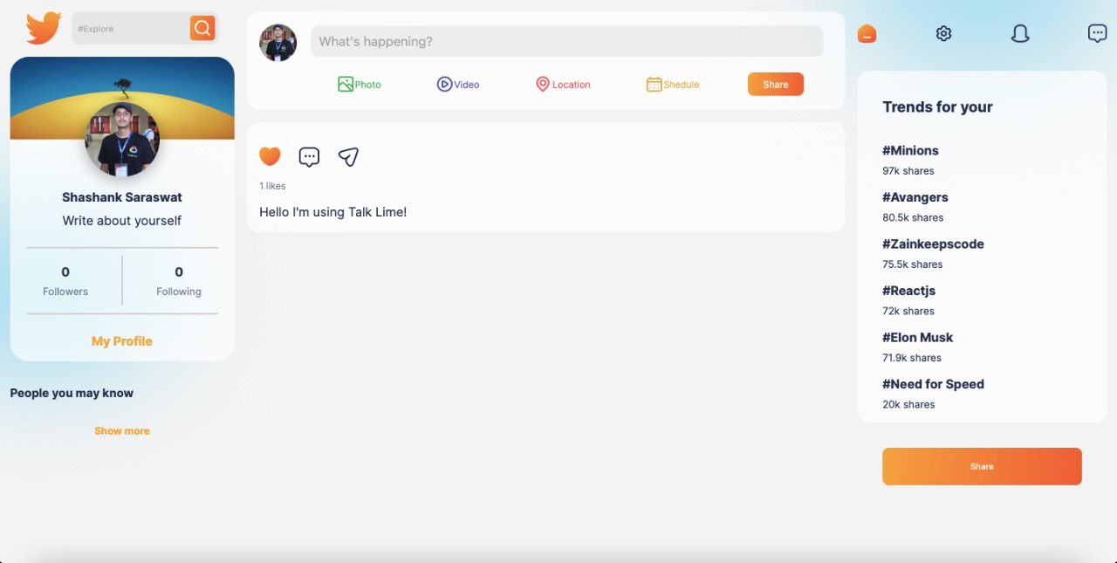
Overlay:

Slide 12
03 System Testing

Slide 13
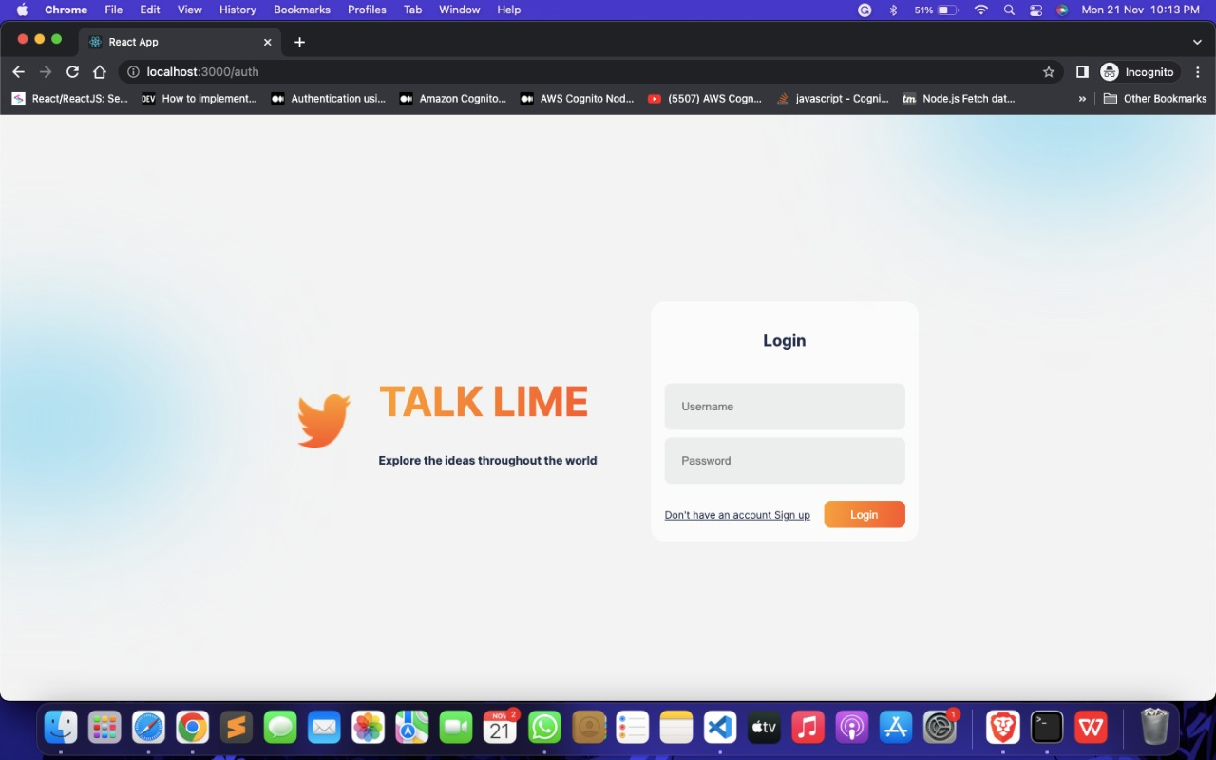
Login:

Slide 14
04 Implementation

Slide 15
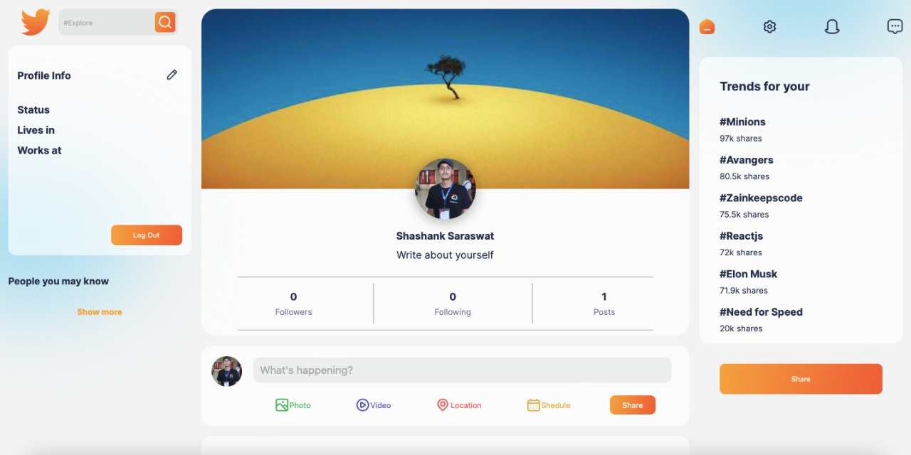
Implementation: The website is finally implemented using React Js, CSS, NodeJs, MongoDB .

Slide 16
THANK YOU

